Slide 1
Big Mountain Ski Resort
Report PresentatIon
Ozgur LezgIyev
4th of August, 2022

Slide 2
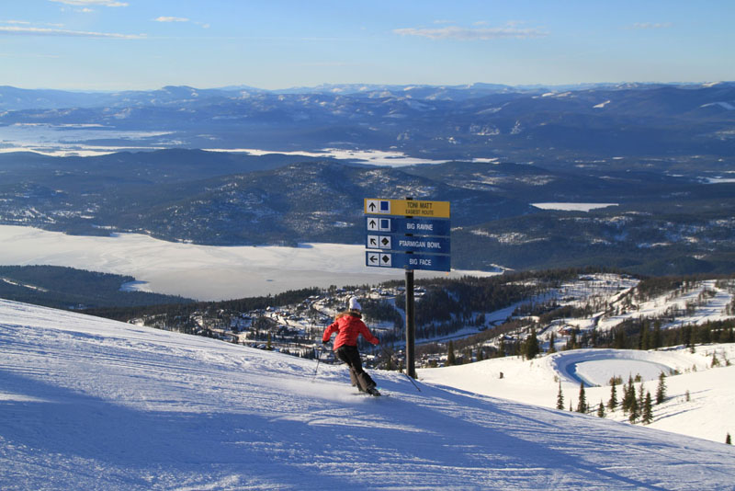
Big Mountain Ski Resort
Located in Montana
Access to 105 trails
Around 350,000 visitors yearly
All-level friendly
11 lifts, 2 T-bars, and 1 magical carpet
3.3 miles of the longest run Hellfire
4,464ft of base elevation
6,817ft summit
Vertical drop of 2,353ft

Slide 3
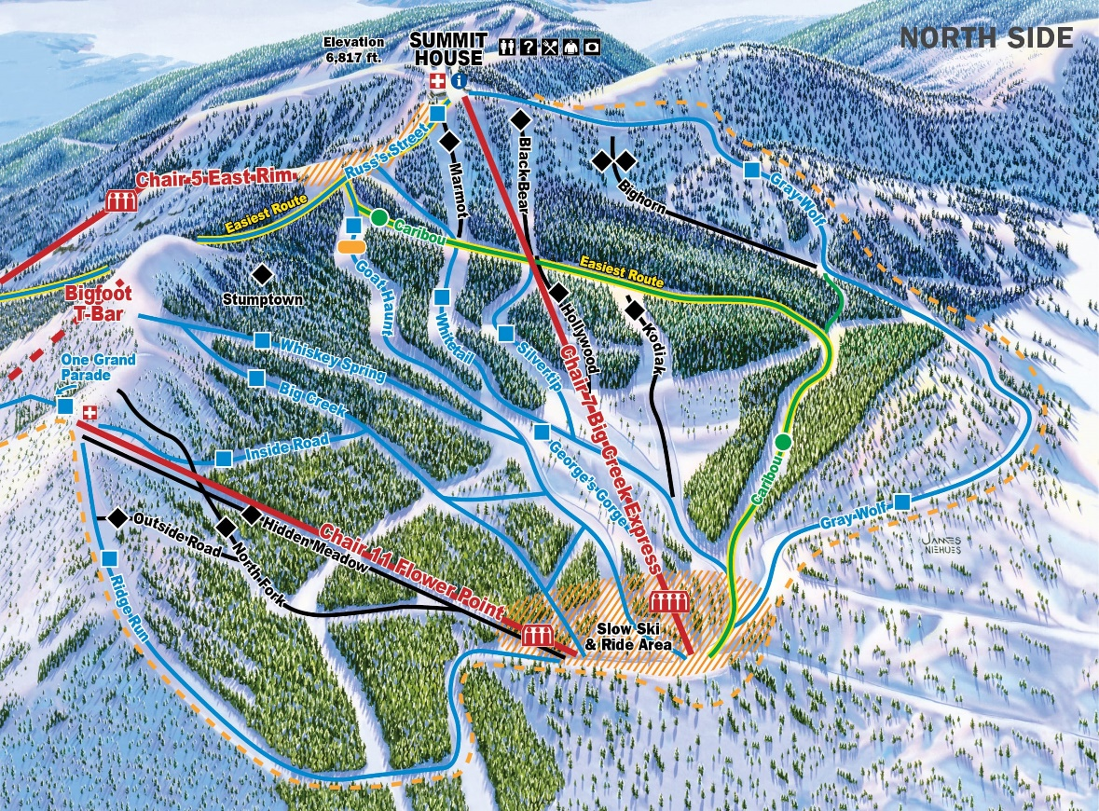
Problem identification
Resort has recently installed an additional lift chair to help increase the distribution of visitors
The chair increases its operating cost by $1.54M this season.
Could Big Mountain Resort compensate for the $1.54M operating cost of the additional chair lift by raising the price of either weekend or weekday tickets?

Slide 4
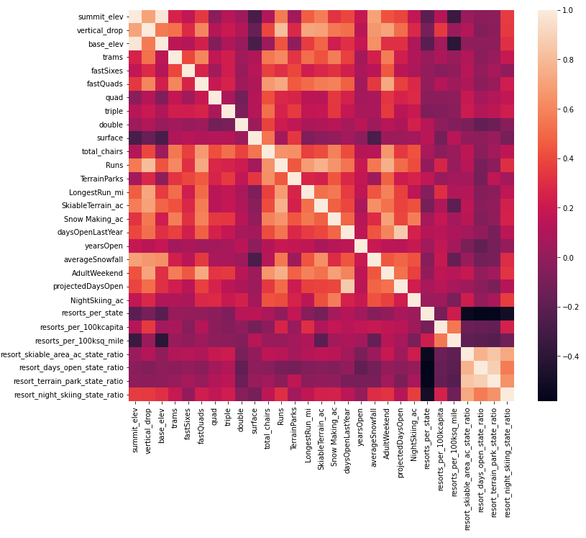
Key Findings
FastQuad, Runs, Snowmaking area covered and vertical drop are has the highest correlation with the ticket price.

Slide 5
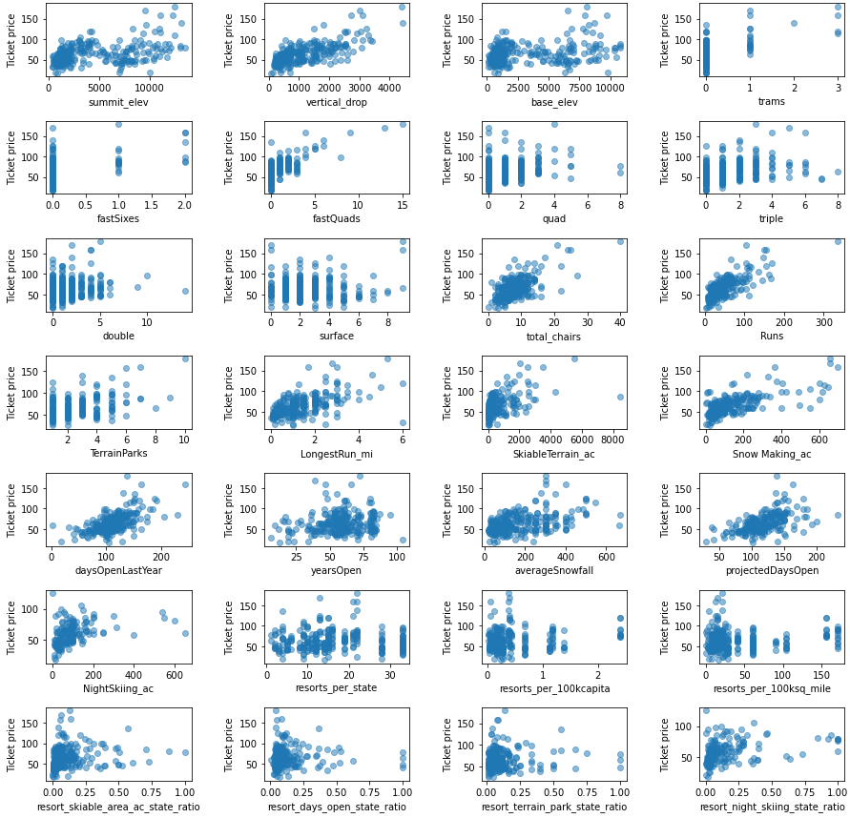
Modeling results and analysis

Slide 6
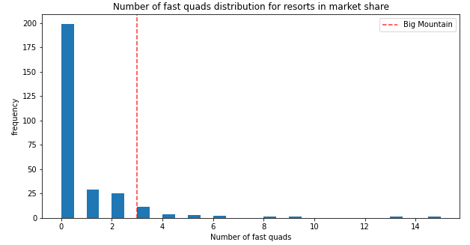
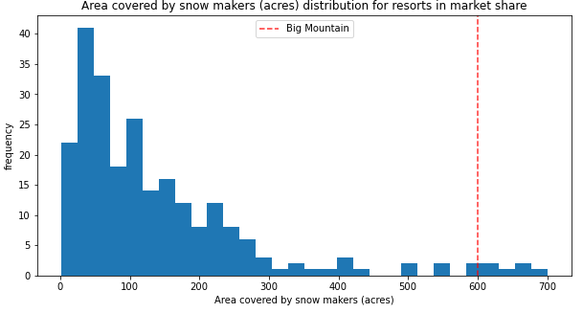
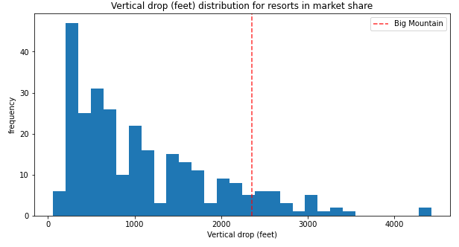
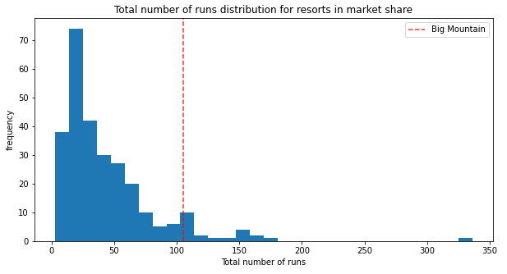
Modeling results and analysis
Most resorts have no fast quads. Big Mountain has 3, which puts it high up that league table.
Big Mountain is very high up the league table of snowmaking areas.
Big Mountain compares well for the number of runs. There are some resorts with more, but not many.
Big Mountain is very high up the league table of vertical drop as well.

Slide 7
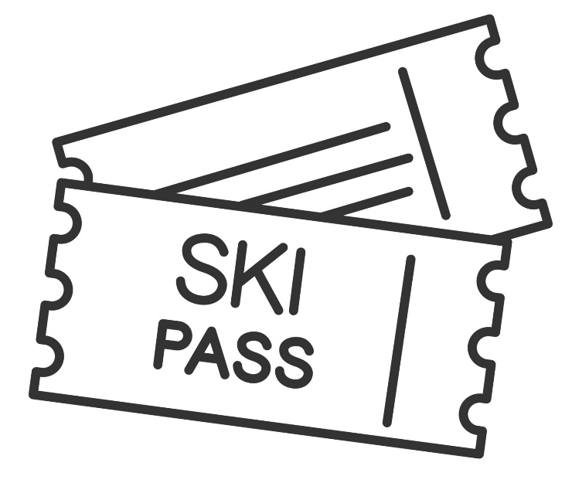
Modeling results and analysis
Big Mountain Resort’s current ticket price is $81.00. My model suggested that to Big Mountain Resort should be charging ~$95.87. Now, the model has a variety of errors equal to $10.39; meaning that Big Mountain Resort certainly has room to increase its price, but the $95.87 is just the model’s prediction of the ticket price and the price should be within +/- $10.39 of the predicted price. Overall, as facilities currently stand, without factoring in final changes, an increase in the ticket price is already justified.

Slide 8
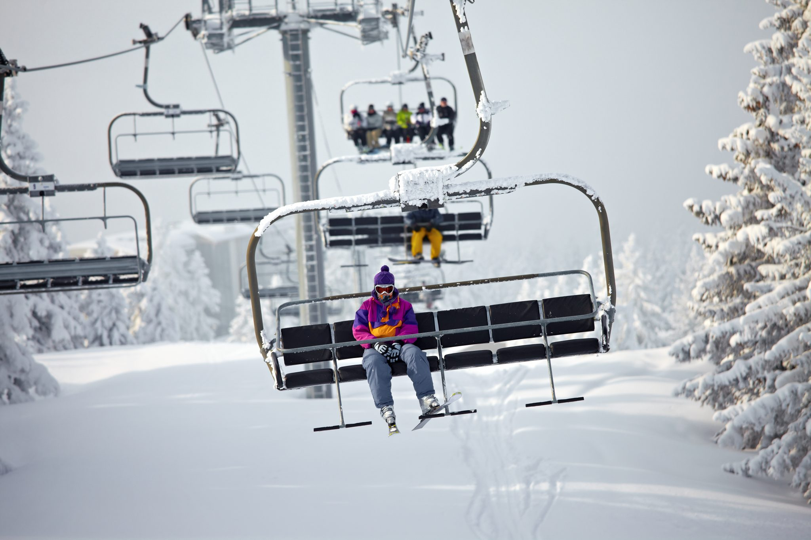
Summary and conclusion
Big Mountain resort could compensate for the $1,540,000 operating cost of an additional chair lift by raising the ticket price supported by increasing the vertical drop by adding a run to a point 150 feet lower down.

